Slide 1

Alternatives to Swagger and OAS
Learn Swagger and the Open API Specification
Other autogenerated docs and other API definition formats

Slide 2
Introduction
Covers
Alternatives to Swagger
DapperDox, Swagger UI variants, ReadMe.io, StopLight.io
Alternatives to OAS
RAML, API Blueprint

Slide 3
Alternatives to Swagger
Swagger is great, but…
Some people think it could be better
In particular, the autogenerated documentation
Not “responsive”, not that pretty, etc.
In theory, you can take OAS files and do whatever you want with them
There are several alternatives to Swagger
Disclaimer: I am not an expert in any of these

Slide 4
DapperDox
http://dapperdox.io

Slide 5
Swagger UI Variants
https://github.com/jensoleg/swagger-ui

Slide 6
ReadMe.io
http://readme.io

Slide 7
StopLight.io
http://stoplight.io

Slide 8
Alternatives to OAS
OAS is just one way to define an API
There are other specifications that have been created
Disclaimer: I am not an expert on these

Slide 9
RAML
RESTful API Modeling Language
More information at: https://raml.org/
Like Swagger, uses YAML
Similar open source tools and some commercial tools
Not as popular as OAS

Slide 10
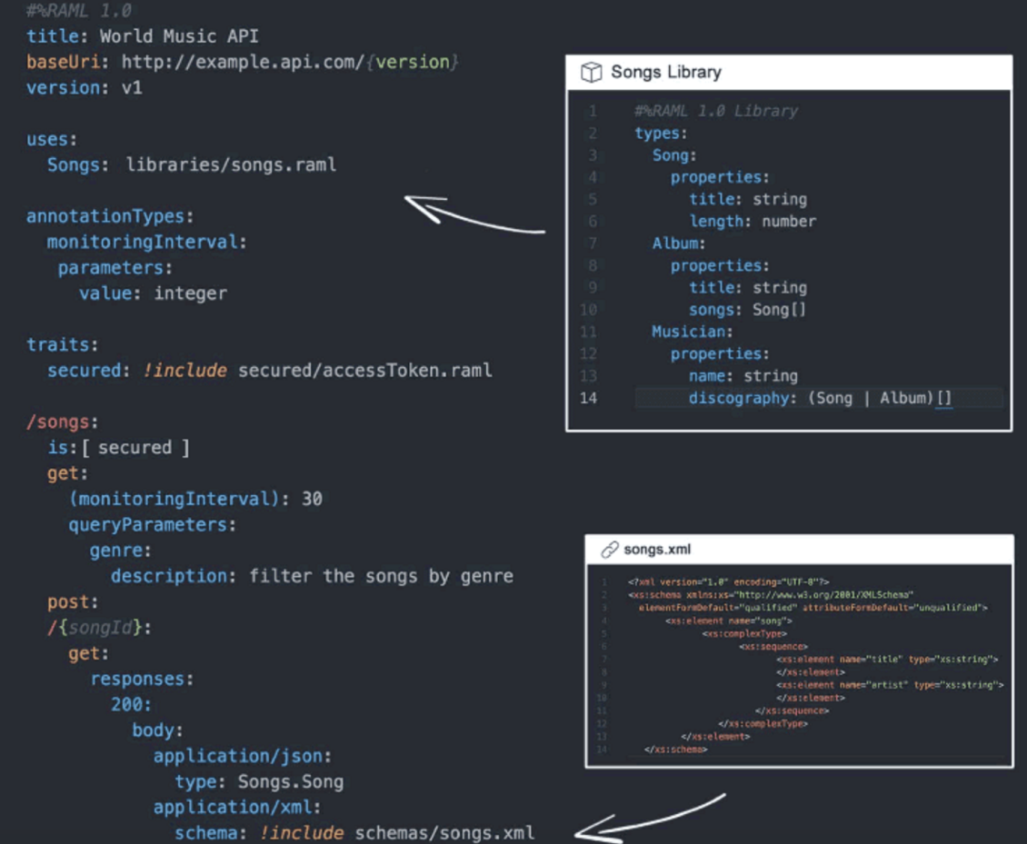
RAML example

Slide 11
API Blueprint
Run by the company Apiary
More information at: https://apiary.io
Markdown files with special formatting
Not as popular as OAS

Slide 12
Apiary example

Slide 13
Final Thoughts
You learned how to define RESTFul APIs using the Open API Specification
You learned how to use Swagger, a set of open source tools that use the Open API Specification
You learned about some alternatives to Swagger and OAS
I expect to see more and better alternatives in the future
Links to the alternatives and other resources are in the next lessonO
Thank you for taking this course
Please check out my other courses

